Slide 1
Introduction to IBM Watson Assistant

Slide 2
Unit objectives
Describe the experiences available in Watson Assistant to build chatbots.
Describe the main components of new Watson Assistant.
Explain how to build a chatbot with Actions and Steps.
Describe the main components of classic Watson Assistant.
Describe how to build a chatbot with Intent, Entities, and Dialog Skills.
Compare action-based conversations and dialog-based conversations.
Describe when and how to migrate from classic to new Watson Assistant.
Test a chatbot.
Explain how to enrich a chatbot.

Slide 3
Topics
Watson Assistant experiences
New Watson Assistant
Classic Watson Assistant
Migrating to the new experience
Enriching the chatbot

Slide 4
Watson Assistant experiences

Slide 5
About Watson Assistant experiences
Use IBM Watson Assistant to build your own branded live chatbot, which is known as an assistant, into any device, application, or channel.
Watson Assistant provides two experiences to build assistants:
New Watson Assistant experience
Classic Watson Assistant experience
Notes:
Use IBM Watson Assistant to build your own branded live chatbot, which is known as an assistant, into any device, application, or channel.
Your chatbot, which is also known as an assistant, connects to the customer engagement resources you already use to deliver an engaging, unified problem-solving experience to your customers.
Watson Assistant provides two experiences to build assistants:
New Watson Assistant experience
Classic Watson Assistant experience

Slide 6
New Watson Assistant experience
In October 2021, the new Watson Assistant became available.
Watson Assistant was revamped to make it easier and faster to build, publish, and improve a chatbot.
The new Watson Assistant has a build experience that is tailored to the people who directly interact with customers daily, such as customer service representatives and customer-care experts.
The new experience is focused on using actions to build customer conversations,
Steps within the action represent back-and-forth interactions between your assistant and your customer.
The new Watson Assistant automatically handles things that might go wrong during a conversation, such as topic changes, vague requests, misunderstandings, and asking for a human agent.
The new Watson Assistant navigation is more intuitive and follows the order of the steps that are recommended to get your assistant live.
Notes:
The new experience refers to the Watson Assistant build experience that was announced on October 7, 2021.
Watson Assistant was revamped to make it easier and faster to build, publish, and improve a chatbot.
The new Watson Assistant has a build experience that is tailored to the people who directly interact with customers daily, such as customer service representatives and customer-care.
The new experience is focused on using actions to build customer conversations,
Steps within the action represent back-and-forth interactions between your assistant and your customer.
The new Watson Assistant automatically handles things that might go wrong during a conversation, such as topic changes, vague requests, misunderstandings, and asking for a human agent.
The new Watson Assistant navigation is more intuitive and follows the order of the steps that are recommended to get your assistant live.
References:
The new Watson Assistant announcement – October 7 2021
https://cloud.ibm.com/docs/assistant?topic=assistant-release-notes#assistant-oct072021
Welcome to the new Watson Assistant (documentation)
https://cloud.ibm.com/docs/watson-assistant
FAQs about the new IBM Watson Assistant experience
https://cloud.ibm.com/docs/watson-assistant?topic=watson-assistant-watson-assistant-faqs#faqs-new-experience
Comparing actions and dialog
https://cloud.ibm.com/docs/watson-assistant?topic=watson-assistant-comparing-actions-dialog
Migrating to the new experience
https://cloud.ibm.com/docs/watson-assistant?topic=watson-assistant-migrate-overview
Switching between new and classic experiences
https://cloud.ibm.com/docs/watson-assistant?topic=watson-assistant-switch-experience

Slide 7
Classic Watson Assistant experience
The classic experience refers to the Watson Assistant build experience that was available before the new experience was announced in October 2021.
The classic experience is built around the following concepts:
Skills
Intents
Entities
Dialog
Customers that built their assistants by using the classic experience can migrate to the new experience or remain in the classic experience.
A dialog-based conversation is the best choice when you want greater control over the logic of the flow.
The dialog flow uses an if-then-else style structure that might be familiar to developers, but not to content designers or customer-care experts.
Notes:
The classic experience refers to the Watson Assistant build experience that was available before the new experience was announced in October 2021.
No matter what the specific purpose of your chatbot is, some core fundamentals are always involved:
Skills
Intents
Entities
Dialog
Each of these functions and their application to the Watson Assistant service are explained in detail in the Classic Watson Assistant topic
The dialog component is optional because some chatbots are developed to answer user questions in a question-and-answer manner that is similar to the approach that is used to answer frequently asked questions (FAQs).
These chatbots need to understand only what the user is asking and reply with the proper answer. Chatbots that are meant to answer FAQs do not have to engage in a conversation with the user and therefore they do not need a dialog component.
Customers that built their assistants by using the classic experience can migrate to the new experience or remain in the classic experience.
A dialog-based conversation is the best choice when you want greater control over the logic of the flow.
The dialog flow uses an if-then-else style structure that might be familiar to developers, but not to content designers or customer-care experts.
References:
About Watson Assistant
https://cloud.ibm.com/docs/assistant?topic=assistant-index
Migrating to the new experience
https://cloud.ibm.com/docs/watson-assistant?topic=watson-assistant-migrate-overview
Comparing actions and dialog
https://cloud.ibm.com/docs/watson-assistant?topic=watson-assistant-comparing-actions-dialog
Switching between new and classic experiences
https://cloud.ibm.com/docs/watson-assistant?topic=watson-assistant-switch-experience
FAQ
https://cloud.ibm.com/docs/assistant?topic=assistant-faqs

Slide 8
New Watson Assistant
Notes:
New Watson Assistant documentation https://cloud.ibm.com/docs/watson-assistant
Watson Assistant blog https://www.ibm.com/blogs/watson/

Slide 9
The new Watson Assistant
The new Watson Assistant experience is focused on using actions to build customer conversations.
New navigation provides a workflow for building, previewing, publishing, and analyzing your assistant.
Each assistant has a home page with a task list to help you get started.
Build conversations with actions, which represent the tasks that you want your assistant to help your customers with.
Each action contains a series of steps that represent individual exchanges with a customer.
When you publish, you can review and debug your work in a draft environment before you go live to your customers.
Use a new suite of analytics to improve your assistant.
Review which actions are being completed to see what your customers want help with, determine whether your assistant understands and addresses customer needs, and decide how can you make your assistant better.
Switching the experience
You can easily switch back and forth between the new experience and the classic experience.
Notes:
The new Watson Assistant experience is focused on using actions to build customer conversations. It is designed to make it simple enough for anyone to build a virtual assistant. Building, testing, publishing, and analyzing your assistant can all now be done in one simple and intuitive interface.
New navigation provides a workflow for building, previewing, publishing, and analyzing your assistant.
Each assistant has a home page with a task list to help you get started.
Build conversations with actions, which represent the tasks that you want your assistant to help your customers with.
Each action contains a series of steps that represent individual exchanges with a customer.
When you publish, you can review and debug your work in a draft environment before you go live to your customers.
Use a new suite of analytics to improve your assistant.
Review which actions are being completed to see what your customers want help with, determine whether your assistant understands and addresses customer needs, and decide how can you make your assistant better.
Switching the experience
You can easily switch back and forth between the new experience and the classic experience. However, the new experience provides a simplified user interface, an improved deployment process, and access to the latest features.
References:
Welcome to the new Watson Assistant
https://cloud.ibm.com/docs/watson-assistant?topic=watson-assistant-welcome-new-assistant
Watson Assistant documentation
https://cloud.ibm.com/docs/watson-assistant
FAQs about the new IBM Watson Assistant experience.
https://cloud.ibm.com/docs/watson-assistant?topic=watson-assistant-watson-assistant-faqs#faqs-new-experience
Getting started with Watson Assistant
https://cloud.ibm.com/docs/watson-assistant?topic=watson-assistant-getting-started
Migrating to the new experience.
https://cloud.ibm.com/docs/watson-assistant?topic=watson-assistant-migrate-overview
Switching between new and classic experiences
https://cloud.ibm.com/docs/watson-assistant?topic=watson-assistant-switch-experience

Slide 10
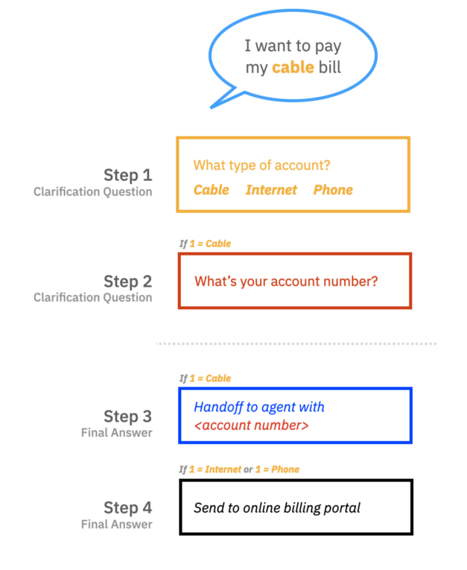
Building your assistant with Action and Step
Like a human personal assistant, the assistant you build helps your customers perform tasks and answer questions. To accomplish this, you define actions for the assistant.
What is an Action?
An action is a problem or a task that your customer wants to resolve. For example, paying a bill, getting an invoice, getting the balance in a bank account, withdrawing money, saying hello, or asking about the weather might all be an action in your assistant.
What is a Step?
A step is a back-and-forth interaction between your assistant and your customer.
Steps represent the clarification questions, final answers, or human agent handoff points in the action.
Notes:
Like a human personal assistant, the assistant you build helps your customers perform tasks and answer questions. To accomplish this, you define actions and steps for the assistant.
An action is a problem or a task that your customer wants to resolve. For example, paying a bill, getting an invoice, getting the balance in a bank account, withdrawing money, saying hello, or asking about the weather might all be an action in your assistant.
An action represents a discrete outcome that you want your assistant to be able to accomplish in response to a user's request. An action comprises the interaction between a customer and the assistant about a particular question or request. This interaction begins with the user input that starts the action (for example, ”I want to withdraw money”). It might then include additional exchanges as the assistant gathers more information, and it ends when the assistant carries out the request or answers the customer's question.
A step is a back-and-forth interaction between the assistant and the customer.
Steps represent the clarification questions, final answers, or human agent handoff points in the action.
Everything else that the step needs to function like the flow logic, response options, or storage of the user’s response is contained within the step.
In the example that is shown in the slide, the assistant asks clarification questions before it hands the conversation over to an agent (with the account number as context) for a cable bill. For internet or phone bills the assistant guides the user to the online billing portal.
An action consists of one or more steps. The steps in an action define the conversation turns that follow the initial customer input that triggered the action. In a simple case, a step might consist of a direct answer to a question from the customer; for example, if the customer asks “What are your business hours?”, a one-step action might reply with “We are open Monday through Friday from 9 AM to 5 PM”.
More commonly, an action requires multiple steps to fully understand the customer's request. For the example, If the customer says “I want to pay my cable bill” the assistant needs more information such as “what is your account number?” Each of these follow-up questions represents a step in the action.
┌ Information ───────────
For step-by-step instructions on the Billing Assistant scenario that is described in this presentation, see the tutorial “Getting Started with the New Watson Assistant: The Build Guide Part I” at https://www.ibm.com/blogs/watson/2021/12/getting-started-with-the-new-watson-assistant-part-i-the-build-guide/
└────────────────────
References:
Getting Started with the New Watson Assistant: The Build Guide Part I
https://www.ibm.com/blogs/watson/2021/12/getting-started-with-the-new-watson-assistant-part-i-the-build-guide/
Getting Started with the new Watson Assistant: Plan It
https://www.ibm.com/blogs/watson/2021/11/getting-started-with-the-new-watson-assistant-plan-it/
Overview: Editing actions
https://cloud.ibm.com/docs/watson-assistant?topic=watson-assistant-build-actions-overview

Slide 11
Actions benefits
Using actions is the best choice when you want to approach the assistant with a focus on content.
The process of creating a conversational flow is easier. People who have expertise with customer care can write the words that your assistant says.
Actions provide better visibility into the customer's interaction and satisfaction with the assistant.
The conversation designer doesn't have to manage data collected during the conversation. By default, your assistant collects and stores information for the duration of the current action.
Many people can work at the same time in separate, self-contained actions. The order of actions within a conversation doesn't matter.
Notes:
Using actions is the best choice when you want to approach the assistant with a focus on content. Actions offers the following benefits:
The process of creating a conversational flow is easier. People who have expertise with customer care can write the words that your assistant says. With a simplified process anyone can build a conversation. You don't need knowledge about machine learning or programming.
Actions provide better visibility into the customer's interaction and satisfaction with the assistant. Because each task is discrete and has a clear beginning and ending, you can track user progress through a task and identify snags.
The conversation designer doesn't have to manage data collected during the conversation. By default, your assistant collects and stores information for the duration of the current action. You don't need to take extra steps to delete saved data or reset the conversation. But if you want, you can store certain types of information, such as the customer's name, for the duration of a conversation.
Many people can work at the same time in separate, self-contained actions. The order of actions within a conversation doesn't matter. Only the order of steps within an action matters. And the action author can use drag and drop to reorganize the steps in the action for optimal flow.
Reference:
Comparing actions and dialog
https://cloud.ibm.com/docs/watson-assistant?topic=watson-assistant-comparing-actions-dialog

Slide 12
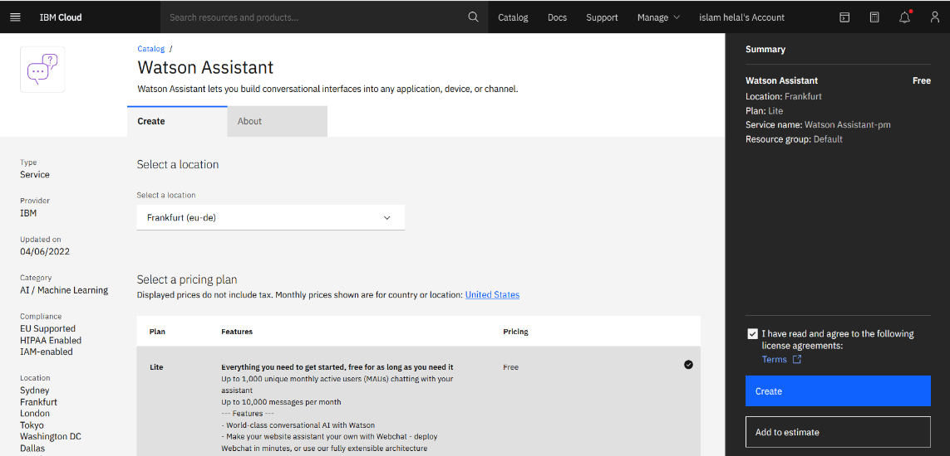
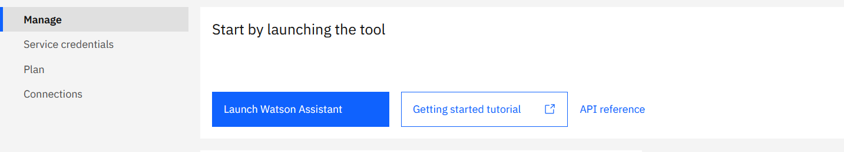
Creating your first assistant
Create a Watson Assistant service instance.
Launch the Watson assistant tool.
1
2
Notes:
To create your first assistant, complete these steps:
Create a Watson Assistant service. You can use an existing Watson Assistant service if you already have one.
After you create the service instance, the dashboard for the instance opens. Click Launch Watson Assistant to open the tool and create your assistant.

Slide 13
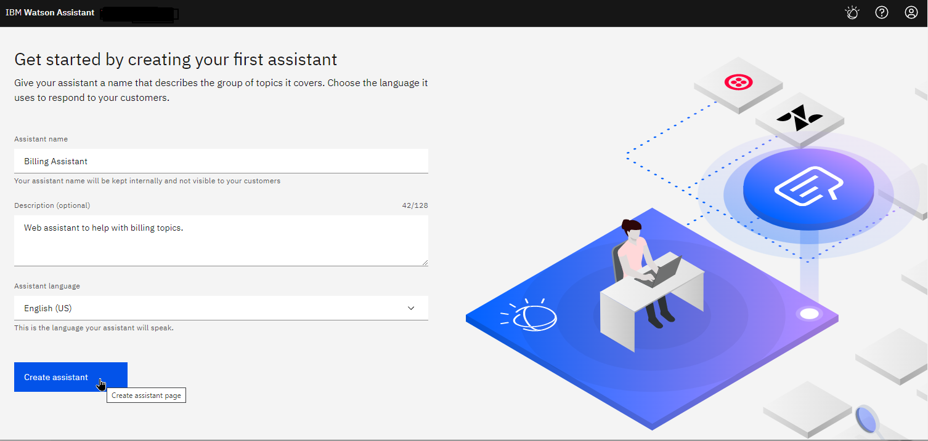
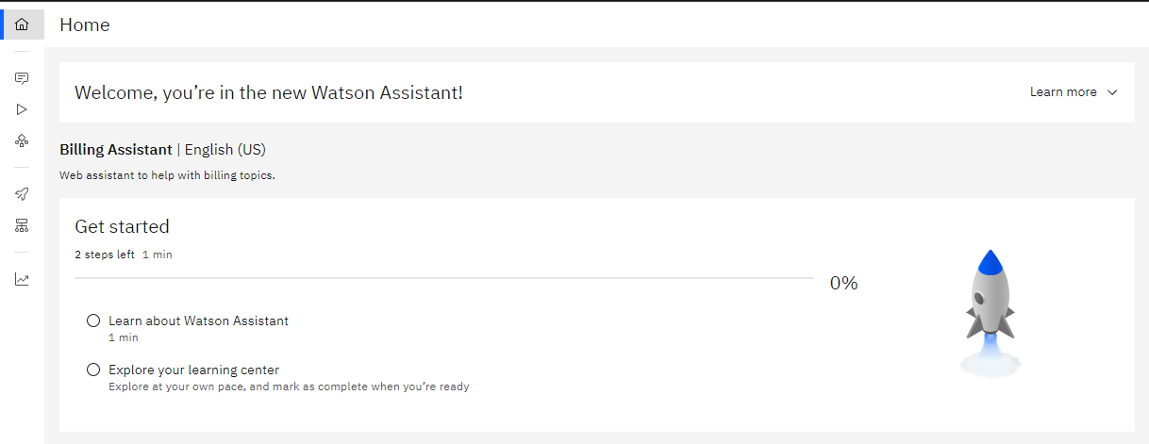
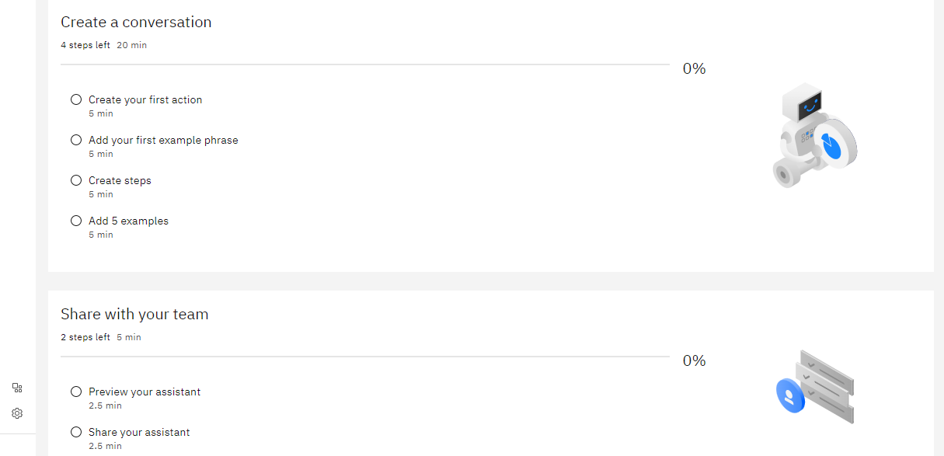
Creating your first assistant (cont.)
Create your assistant. Example, Billing Assistant.
The assistant Home page opens.
3
4
Notes:
Give your assistant a name that describes the group of topics it covers. In this example, Billing Assistant. Choose the language it uses to respond to your customers and click Create assistant.
The Home page of your assistant is displayed.

Slide 14
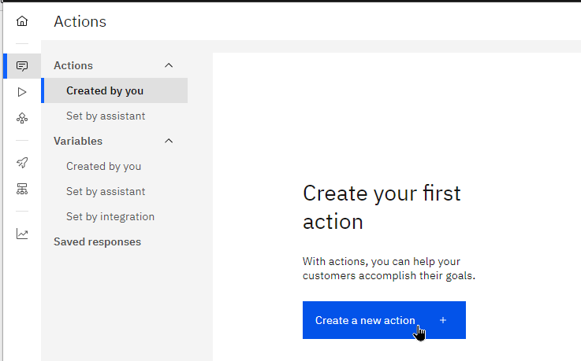
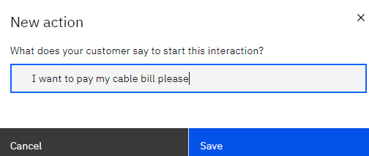
Creating your first Action
Actions represent the topics that your assistant can handle, for example “pay bill”.
Enter an example of the customer interaction. You “train” your assistant’s topic-recognition AI by giving it example sentences.
When you create a new action, you are prompted to provide the first example like “I want to pay my cable bill please”.
Notes:
Actions represent the tasks or questions that your assistant can help customers with. Each action has a beginning and an end, making up a conversation between the assistant and a customer.
When you create a new action, Watson Assistant prompts you for an example of the customer’s input that starts the action.
From the navigation panel on the left click Actions to create a new action and then click Create a new action.
In the “New action” window, at the prompt "What does your customer say to start this interaction?", type an example of your customers interactions for this action. In this example, “I want to pay my cable bill please”.

Slide 15
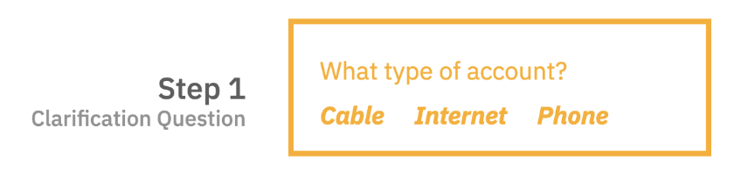
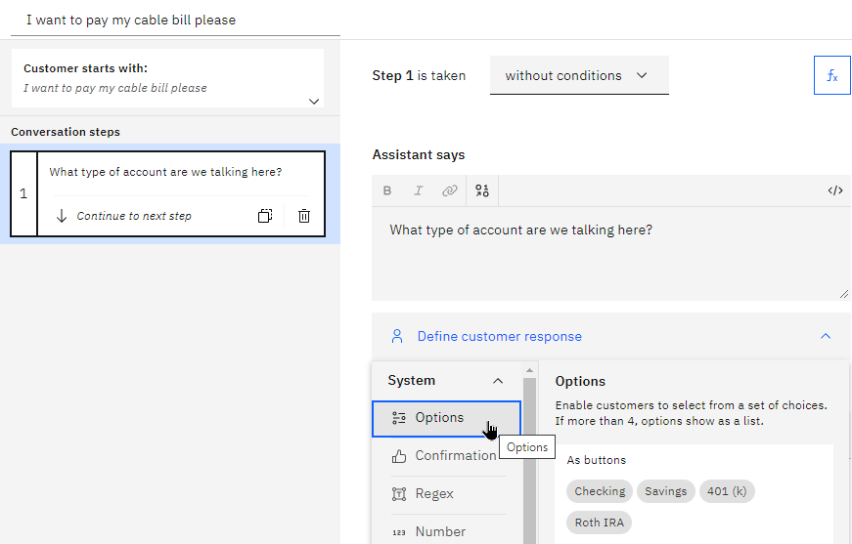
Creating your first Step – Step 1
Add a step to ask a clarification question, for example, the type of account, which has a bill that needs to be paid. Step 1 is created by default.
Add the clarification question in the “Assistant says” text box.
Select the type of customer response that the assistant should wait for. In this case, Options is the best choice.
Notes:
Now it’s time to create the first step in the bill pay interaction.
Step 1 is already created for you.
Select the step to edit it and add the clarification question in the “assistant says” text box. In this example, “What type of account are we talking here?”.
Then, select the type of customer response that the assistant should wait for. In this case, Options is the best choice.

Slide 16
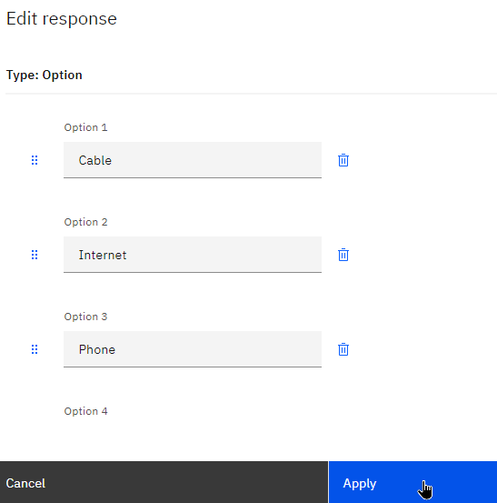
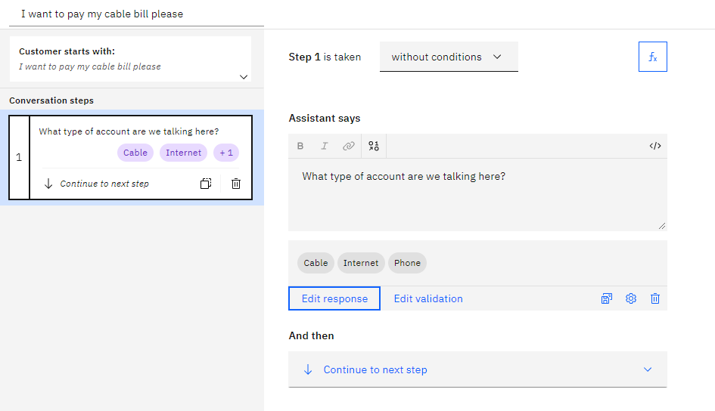
Creating your first Step – Step 1 (cont.)
Add the three options for Cable, Internet, and Phone, and apply your changes.
Notes:
Add the three options for Cable, Internet, and Phone, and apply your changes.
Finally, the first step looks as shown in the figure on the right.

Slide 17
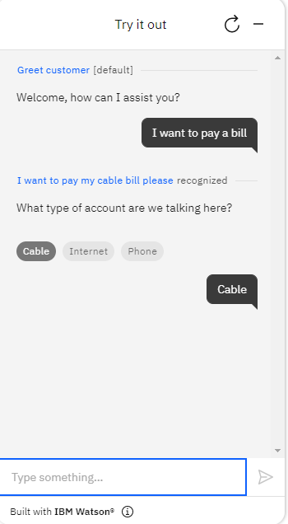

Trying out your action
Click Try it to preview your action to make sure it works.
Notes:
Now preview your action to make sure it works.
Click Try it in the lower right of your screen. Try out a few interactions and see that it properly recognizes what you ask it. Try typing something other than what you used as your training sentence.

Slide 18
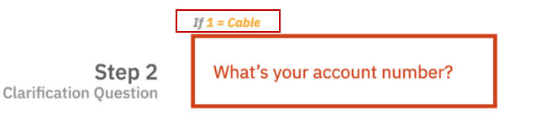

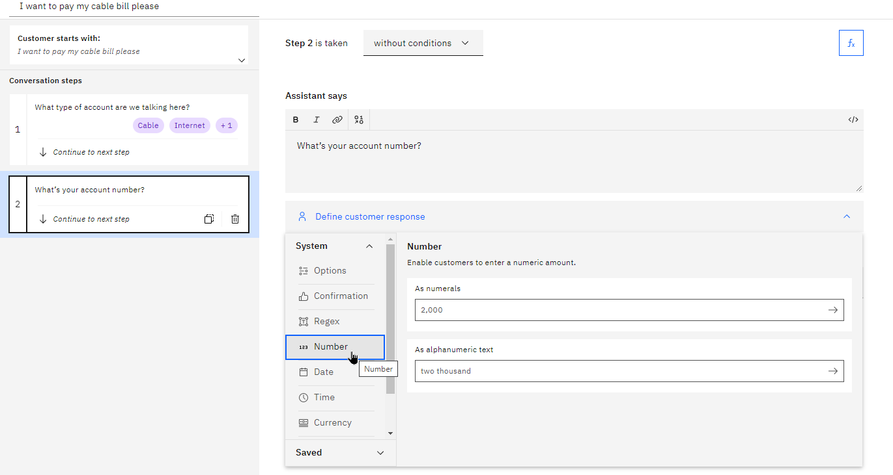
Adding more steps to the conversation – Step 2
Add a step to ask a clarification question, for example, the account number.
Click New step
Add the clarification question What’s your account number?
Select Number for the type of customer response.
Notes:
The steps in an action define the conversation turns that follow the initial customer input that triggered the action. In a simplest case, a step might consist of a direct answer to a question from the customer; for example, if the customer asks. What are your business hours?, a one-step action might reply with “We are open Monday through Friday from 9 AM to 5 PM”.
Usually, an action requires multiple steps to fully understand the customer's request.
For example, if the customer wants to pay a bill, the assistant needs to know the account number.
If the customer asks, “I want to withdraw money”, the assistant needs more information:
Which account should the money come from?
What is the amount to withdraw?
Each of these follow-up questions represents a step in the action.
In this example:
Add Step 2 below Step 1 by clicking New step.
In the “Assistant says” field, type the clarification question to ask for the account number, “What’s your account number?”.
Select Number from the response drop-down list as the type of customer response.

Slide 19
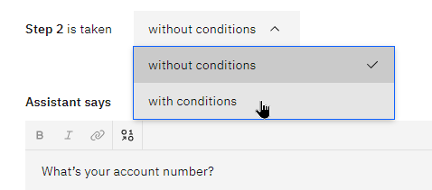
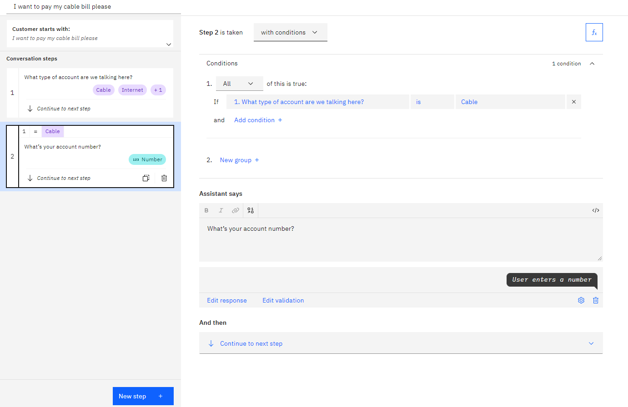
Adding logic (conditions) to the flow – Step 2
In this example, the customer should be prompted for an account number only for cable bills.
Add a condition to Step 2.
Step 2 is taken with conditions.
Condition: answer to step 1 = Cable but not Internet or Phone.
Notes:
Next, you need to add some flow logic to the flow. In this example, given the way that this flow works, an account number should be gathered only for cable bills. To handle this scenario, you need to add a condition to your step. To do that, change the step to be taken with conditions instead of without.
Conditions are basically requirements, which must be met for the step to be triggered. In this case, you want to condition on the answer to step 1 being “Cable” but not Internet or Phone. To set it up, make sure that you have the condition set to step 1 = Cable.

Slide 20

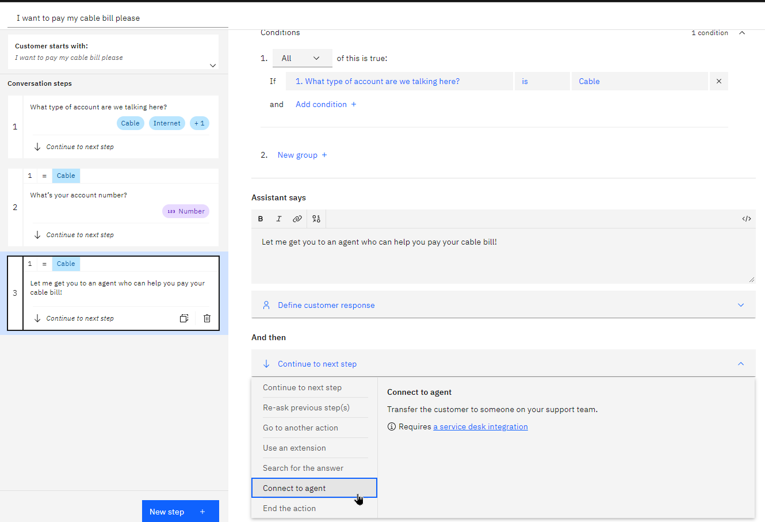
Adding an agent handoff step – Step 3
Add step 3 under step 2.
Enter text related to getting the user to an agent to pay their bill. “Let me get you to an agent who can help you pay your cable bill!.”
Condition step 3 on “step 1 = Cable”.
For this step, you don’t need to gather any information from the user, so you can leave the Define customer response section empty.
Change And then to Connect to agent.
Notes:
Now, you need to add the last steps to provide the outcome to the user.
Add step 3 under step 2.
Enter some text related to getting the user to an agent to pay their bill. For example, “Let me get you to an agent who can help you pay your cable bill!.”
Condition step 3 on “step 1 = Cable” as you did in step 2.
For this step, you don’t need to gather any information from the user, so you can leave the “Define customer response” section empty.
Now, set up the assistant to route this conversation to a human agent. Change the And then setting to Connect to agent (connect to a human agent), which also ends the action when it hands off.

Slide 21
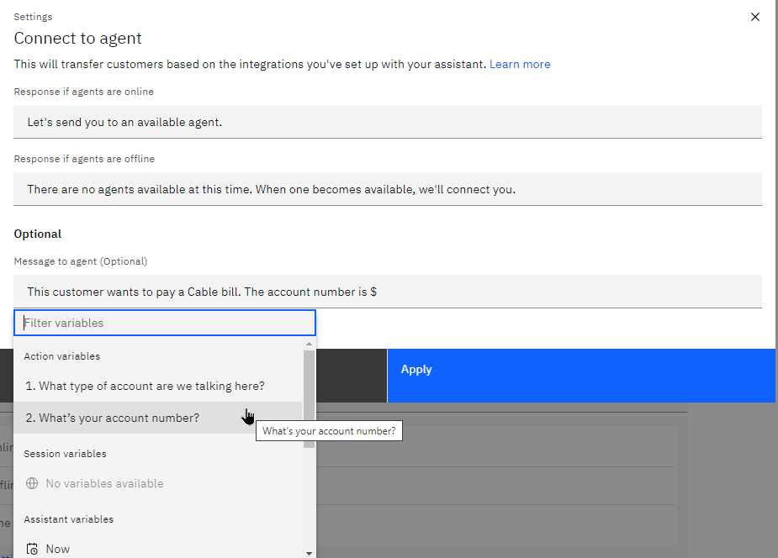
Inserting the context to pass to the human agent – Step 3
Insert the context that you gathered for the human agent to review.
The customer wants to pay their Cable bill.
The account number. Select step 2 (the account number) as the field that you want to insert
Apply your changes.
Hint: To insert the content of the variables that you collected into text, start with the “$” sign and a quick select box appears as shown in the figure.
Notes:
In the prompt that comes up, you insert the context that you gathered for the human agent to review. Namely, the fact that the customer wants to pay their Cable bill and the account number.
┌ Hint ─────────────────
To insert the content of the variables that you collected into text, start with the “$” sign and a quick select box appears as shown in the figure.
└────────────────────
Insert the context that you gathered for the human agent to review.
The customer wants to pay their Cable bill.
The account number. Select step 2 (the account number) as the field that you want to insert
Apply your changes.

Slide 22
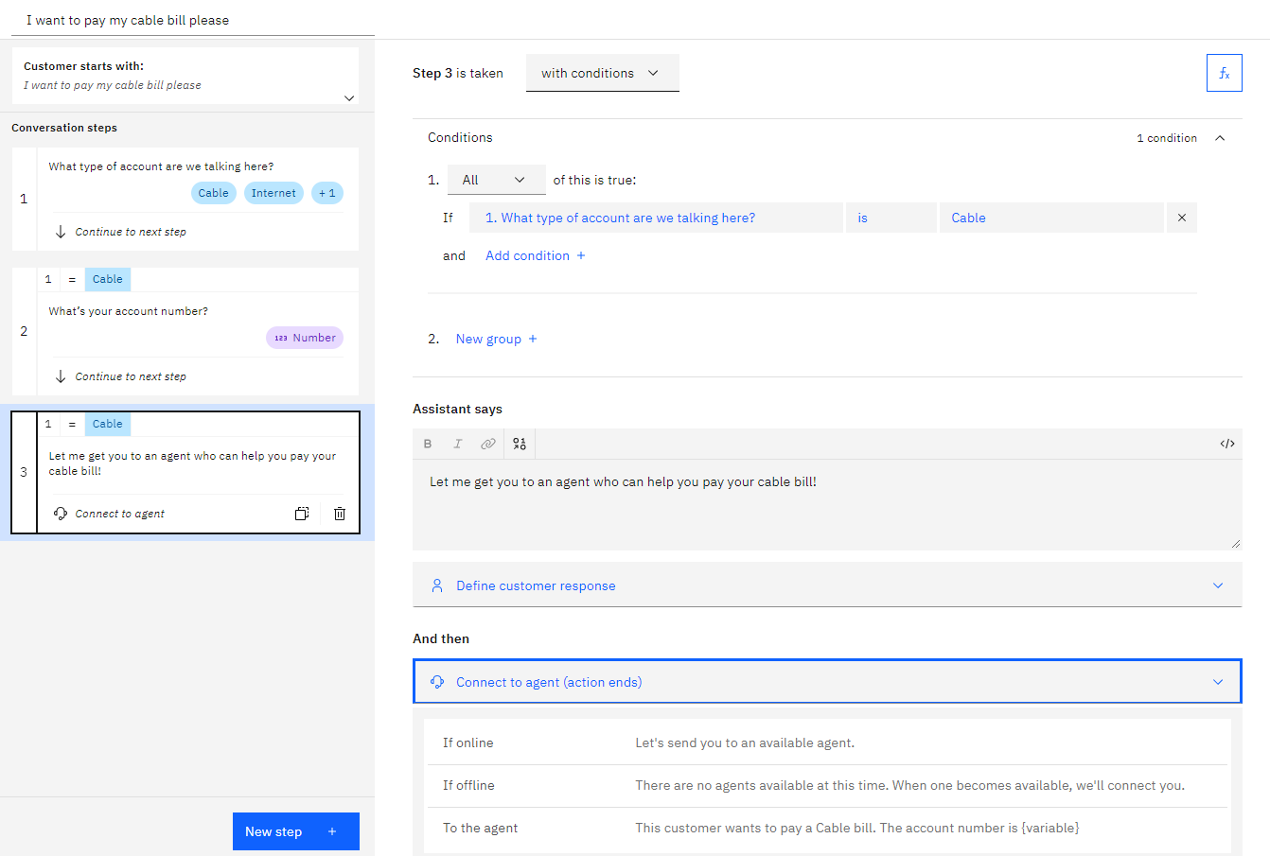
Handoff to agent step wrap-up – Step 3
Notes:
The slide shows the completed step 3, which derives the customer to a human agent and passes the context that is collected from the user.

Slide 23
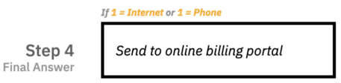
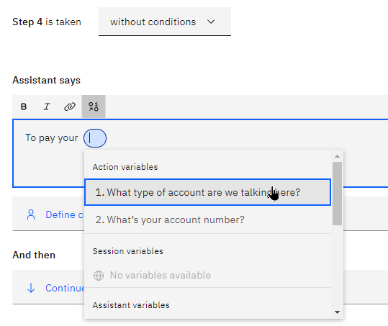

Creating a final response – Step 4 (1 of 5)
Add a final step to wrap up the conversation. Step 4 tells the customer, To pay your <type of bill> bill, you can head to our online portal <link to portal>
To insert a variable like the type of bill to be paid, click the Insert a variable button that is located over the text box.
Notes:
Add a final step to wrap up the conversation. Step 4 tells the customer, “To pay your <type of bill> bill, you can head to our online portal <link to portal>”
To insert a variable like the type of bill to be paid, click the Insert a variable button that is located over the text box.

Slide 24
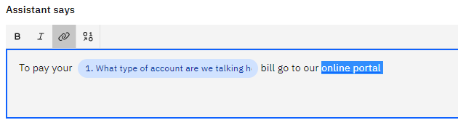
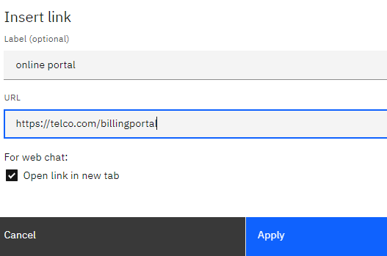
Creating a final response – Step 4 (2 of 5)
To add a link to the text, highlight the text that you want to use and then click the Link button.
Enter the URL in the “Insert link” window.
Notes:
To add a link to the text, highlight the text that you want to use and then click the Link button.
Enter the URL in the “Insert link” window.
The settings for the link look like the figure.

Slide 25
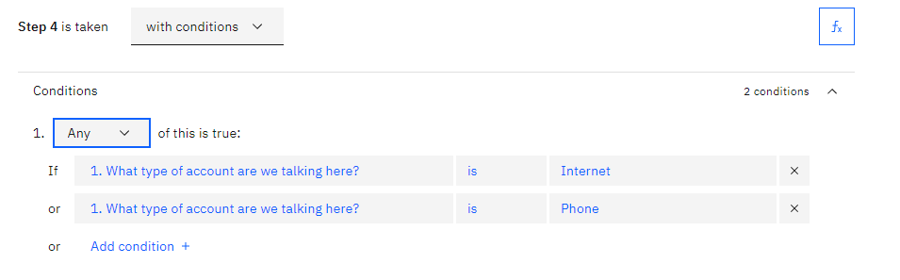
Creating a final response – Step 4 (3 of 5)
This step must run only for an Internet or Phone bills.
Create a condition on “step 1 = Internet.”
Add another condition for “step 1 = Phone.”
Ensure that the step runs when Any of these conditions are met.
Notes:
Next, make sure that this step only runs for an Internet or Phone bill. To accomplish this goal, create a condition on “step 1 = Internet.” Then, add another condition for “step 1 = Phone.” Ensure that this step is triggered when Any of these conditions are met (not All of them.)

Slide 26
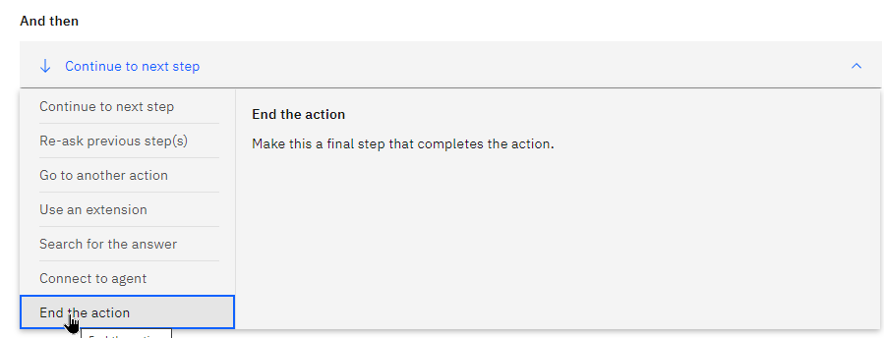
Creating a final response – Step 4 (4 of 5)
The action must end after this step is reached.
Change the “And then” setting to End the action.
Notes:
Finally, make sure that the action ends after this step is reached. Change the “And then” setting to End the action.

Slide 27
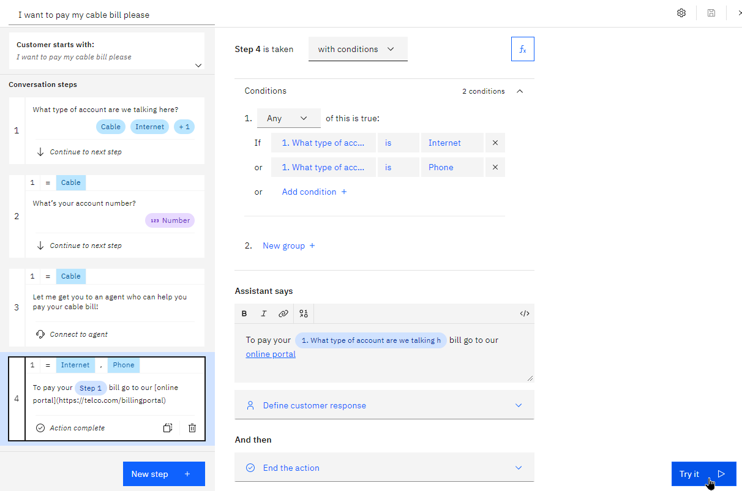
Creating a final response – Step 4 (5 of 5)
Notes:
Your steps now are completed and look like shown in the figure.
Click Try it to test a few scenarios.

Slide 28
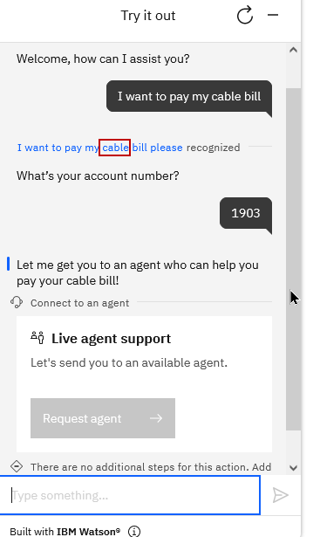
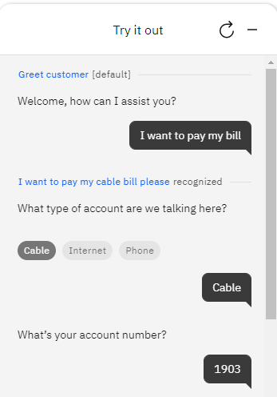
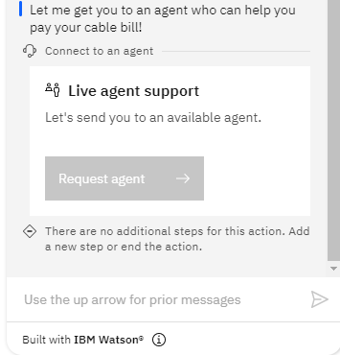
Try it out (1 of 2)
Notes:
Try a few scenarios. Notice that when you state the type of bill up front, the assistant skips the question about the type of bill and moves immediately to the next step.

Slide 29
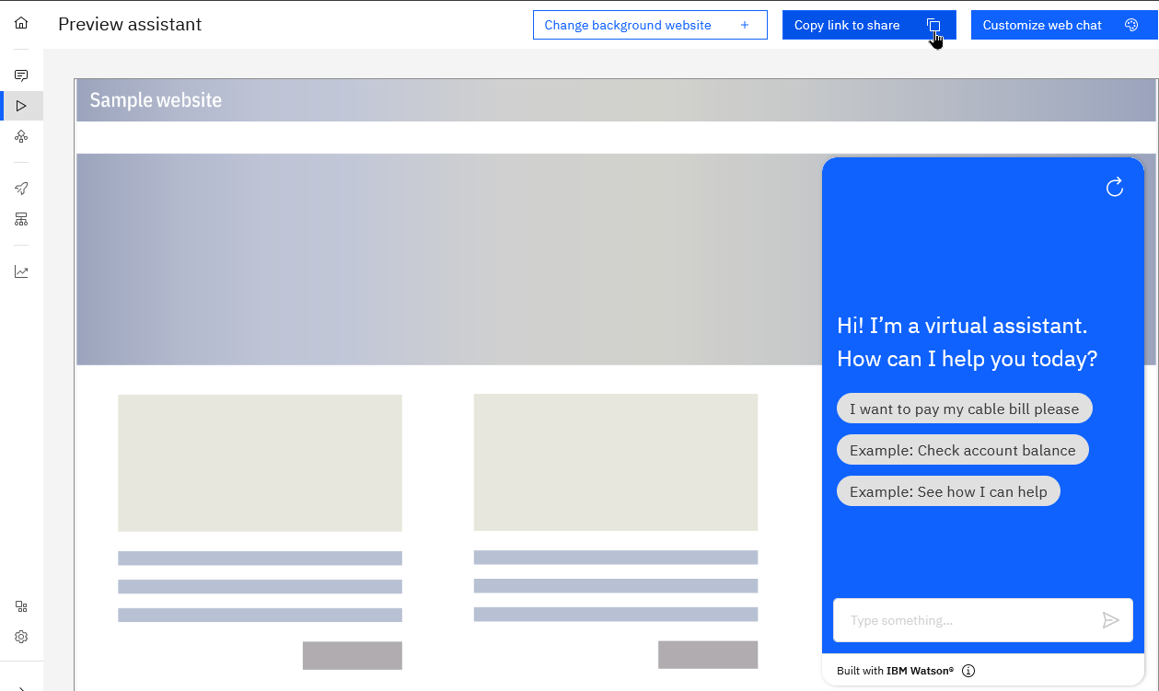
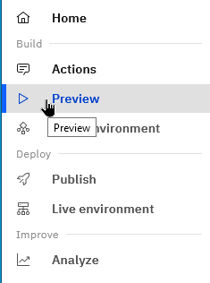
Get a real-life preview of your assistant: Preview
Notes:
To see how your assistant would really work on one of your channels, open the preview page.
The preview page is a representation of your “draft” work in progress and has an inline preview for you to test. You can also share your work with others on your team quickly with a sharable URL

Slide 30
Classic Watson Assistant
Notes:
Classic Watson Assistant documentation https://cloud.ibm.com/docs/assistant?topic=assistant-index

Slide 31
When to use classic Watson Assistant?
Reasons for using classic Watson Assistant include:
The assistant was built before the new Watson Assistant became available in October 2021.
Your developers are familiar and comfortable with the classic experience.
You want greater control over the logic of the flow.
The dialog editor exposes more of the underlying artifacts (such as intents and entities) used to build the AI models.
The dialog flow uses an if-then-else style structure that might be familiar to developers, but not to content designers or customer-care experts.
The following features are available in dialog-based conversations but not in Actions.
Contextual entities
Detection of other system entities
Image response type
Digression support
Webhook (log all messages) support
Notes:
┌ Hint ─────────────────
Want to get started with actions, but need features that are available from a dialog? Use both. Dialog is your primary conversation with users, but you can call an action from your dialog to perform a discrete task. For more information see Calling actions from a dialog at https://cloud.ibm.com/docs/watson-assistant?topic=watson-assistant-dialog-call-action
└────────────────────
References:
Comparing actions and dialog
https://cloud.ibm.com/docs/watson-assistant?topic=watson-assistant-comparing-actions-dialog
Annotation-based method - Contextual entities
https://cloud.ibm.com/docs/assistant?topic=assistant-entities#entities-annotations-overview
Handling Watson Assistant response types
https://www.ibm.com/docs/en/voice-gateway?topic=states-handling-watson-assistant-response-types
Response type image
https://www.ibm.com/docs/en/voice-gateway?topic=states-handling-watson-assistant-response-types#wa_response_type_image
Understanding dialog skill digressions
https://cloud.ibm.com/docs/assistant?topic=assistant-tutorial-digressions
Webhook overview
https://cloud.ibm.com/docs/assistant?topic=assistant-webhook-overview

Slide 32
Components
Classic Watson Assistant main components:
Assistants
Dialog skills
Intents
Entities
Dialog
Notes:
The Watson Assistant main components are:
Assistants
Dialog skills
Intents
Entities
Dialog

Slide 33
Assistant
Assistant:
A cognitive bot that you can customize for your business needs.
A dialog is activated from the assistant settings.
The assistant can be deployed through multiple interfaces, such as:
Messaging channels, like Slack and Facebook Messenger.
A simple chat widget on a website or on an existing company web page.
A custom application, such as a mobile app or a robot with a voice interface.
Notes:
Assistants
An assistant is a cognitive bot that you can customize for your business needs and deploy across multiple channels to help your customers where and when they need it.
You customize the assistant by adding to it the skills that it needs to satisfy your customers' goals.
Activate a dialog skill that can understand and address questions or requests with which your customers typically need help. You provide information about the subjects or tasks that your users ask about and how they ask about them. Then, the service dynamically builds a machine learning model that is tailored to understand the same and similar user requests.
You can deploy the assistant through multiple interfaces, including:
Existing messaging channels, such as Slack and Facebook Messenger.
You can give your users access to the assistant through a simple chat widget that you publish to a website or add to an existing company web page.
You can design a custom application that incorporates it by making direct calls to the underlying APIs.

Slide 34
Dialog skill
Dialog skill:
Acts as a container for all of the artifacts and training data.
A skill contains the following types of artifacts:
Intents
Entities
Dialog
A skill uses the training data to build a machine learning model to recognize similar user inputs.
When you add or change the training data, the training process is triggered to ensure that the underlying model stays up to date.
Notes:
Skill
Sometimes referred to as dialog skill.
A Dialog skill acts as a container that contains the training data and logic that enables an assistant to help your customers.
It contains the following types of artifacts:
Intents
Entities
Dialog
As you add information, the data is used to build a machine learning model that can recognize these and similar user inputs. Each time that you add or change the training data, the training process is triggered to ensure that the underlying model stays up-to-date as your customer needs and the topics they want to discuss change.

Slide 35
Intent
Intent:
Represents the purpose of or goal of a user's input.
Tends to be general, such as a question about business location or a bill payment.
For intent creation:
Plan the intents for application. Define an intent for each type of user request that you want your application to support.
Teach Watson Assistant about your intents. Supply many examples of user input and indicate the intents to which they map.
In the tool, the name of an intent is always prefixed with ’#’. For example, #payment or #inquiry.
Notes:
Intent
An intent represents the purpose of a user's input, such as a question about business locations or a bill payment.
Plan the intents for an application: Consider what your customers might want to do and what you want your application to be able to handle on their behalf. For example, you might want your application to help your customers make a purchase. If so, you can add a #buy_something intent.
You define an intent for each type of user request that you want your application to support.
Teach Watson Assistant about your intents: After you decide the business requests that you want your application to handle for your customers, you must teach Watson Assistant about them. For each business goal (such as #buy_something), you must provide at least 10 examples of utterances that your customers typically use to indicate their goal. For example, “I want to make a purchase.”
Ideally, find real-world user utterance examples that you can extract from existing business processes. The user examples should be tailored to your specific business. For example, if you are an insurance company, your user examples might look more like this, “I want to buy a new XYZ insurance plan.”
To train the dialog skill to recognize your intents, supply many examples of user input and indicate to which intents they map. The examples that you provide are used by the service to build a machine learning model that can recognize the same and similar types of utterances and map them to the appropriate intent.
In the tool, the name of an intent is always prefixed with the # character.
Start with a few intents and test them as you iteratively expand the scope of the application.

Slide 36
Intent (cont.)
Intent examples:
“Good morning” -> #greeting.
“Where can I find the nearest restaurant?” -> #location_info.
“Where can I pay my electric bill?” -> #location_info.
Remember: Intents represent what the user wants to achieve: a goal, an action, or verbs.
Notes:
Intent examples:
“Good morning” -> #greeting
“Where can I find the nearest restaurant?” -> #location_info
“Where can I pay my electric bill?” -> #location_info
Remember: Intents represent what the user wants to achieve: a goal, an action, or verbs.

Slide 37
Entity
Entity
Represents a term or object that is relevant to the user’s intent and that provides a specific context for an intent.
If intents represent verbs (the action a user wants to do), entities represent nouns (the object of, or the context for that action).
By recognizing the entities that are mentioned in the user's input, the service can reply with a more targeted response or perform a required action.
In the tool, the name of an entity is always prefixed with ’@’. For example, @street or @contact_info.
Notes:
Entity
Entities represent information in the user input that is relevant to the user's purpose.
If intents represent verbs (the action a user wants to do), entities represent nouns (the object of, or the context for, that action). For example, when the intent is to get a weather forecast, the relevant location and date entities are required before the application can return an accurate forecast.
Entities represent a class of object or a data type that is relevant to a user’s purpose. By recognizing the entities that are mentioned in the user's input, the service can reply with a more targeted response or perform a required action.

Slide 38
Entity evaluation
The Assistant service looks for terms in the user input by using exact matching of values, synonyms, or patterns that are defined for the entities.
Synonym entity:
Specify a bunch of synonyms, that is, words that have exact or similar meanings.
For example, for the entity value Blue, its synonyms can be Aqua, Navy, and Cyan.
Pattern entity:
You specify a regular expression that defines the pattern for mentions.
For example, for email patterns such as name@ibm.com, the pattern can be:
\b[A-Za-z0-9._%+-]+@[A-Za-z0-9.-]+\.[A-Za-z]{2,}\b
Notes:
The Assistant service looks for terms in the user input that match the values, synonyms, or patterns that you define for the entity:
Synonym entity: Synonyms are words or phrases that mean exactly or nearly the same as the corresponding entity. You define a category of terms as an entity (color), and then one or more values in that category (blue). For each value, you specify several synonyms (aqua, navy, and cyan). At run time, the service recognizes terms in the user input that exactly match the values or synonyms that you defined for the entity as mentions of that entity.
Pattern entity: You define a category of terms as an entity (contact_info), and then define one or more values in that category (email). For each value, you specify a regular expression that defines the textual pattern of mentions of that value type. For an email entity value, you might want to specify a regular expression that defines a text@text.com pattern. This email regex example can capture all mentions of emails in their proper format. At run time, the service looks for patterns matching your regular expression in the user input, and identifies any matches as mentions of that entity.

Slide 39
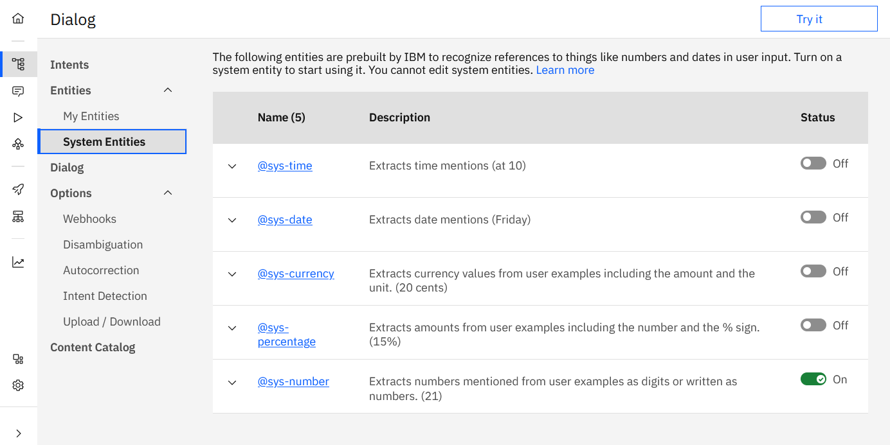
Entity evaluation (cont.)
System entity: A synonym entity that is prebuilt by IBM (such as numbers, dates, or others).
Notes:
System entity: A synonym entity that is prebuilt for you by IBM. They cover commonly used categories, such as numbers, dates, and times. You simply enable a system entity to start using it.

Slide 40
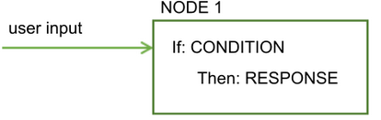
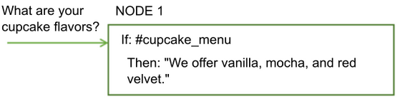
Dialog
Dialog
A dialog is a branching conversation flow that defines how your application responds when it recognizes the defined intents and entities.
The dialog is made up of nodes that are chained together in a tree structure (graphically).
Each node includes conditions for the node to be active, and also an output object that defines the response that is provided.
Think of the node as an if-then construction: If this condition is true, then return this response.
User
Notes:
Dialog
A dialog is a branching conversation flow that defines how your application responds when it recognizes the defined intents and entities.
The dialog is made up of nodes that define steps in the conversation.
Dialog nodes are chained together in a tree structure (graphically).
Each node includes conditions for the node to be active, and also an output object that defines the response that is provided.
Think of the node as an if-then construction: If this condition is true, then return this response.
Condition: Specifies the information that must be present in the user input for this node in the dialog to be triggered.
Response: The utterance that the service uses to respond to the user.

Slide 41
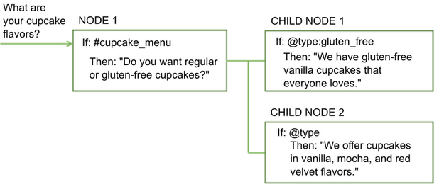
Dialog (cont.)
Dialog (cont.)
A single node with one condition and response can handle simple user requests.
To handle more complex tasks, you can add child nodes to ask the user for additional information.
Notes:
Dialog
A single node with one condition and response can handle simple user requests.
To handle more complex tasks, you can add child nodes to ask the user for additional information.
A child node is processed after its parent node. NODE 1 is the parent node for CHILD NODE 1 and CHILD NODE 2.
Some useful definitions:
A root node is a node that does not depend on other nodes. In the example, NODE 1 is a root node.
A child node is a node that depends on another node, its parent node. The parent node is processed first, and based on that processing, the child node is either processed or not.

Slide 42
Conditions
Conditions
Logical expressions that are evaluated to true or false.
A node condition determines whether that node is used in the conversation.
Conditions usually evaluate the intents and entities that are identified in the user responses, but they can also evaluate information that is stored in the context.
Notes:
Conditions
Conditions are logical expressions that are evaluated to true or false. A node condition determines whether that node is used in the conversation or to choose among the possible responses to the user.
Conditions usually evaluate the intents and entities that are identified in the user responses, but they can also evaluate information that is stored in the context.

Slide 43
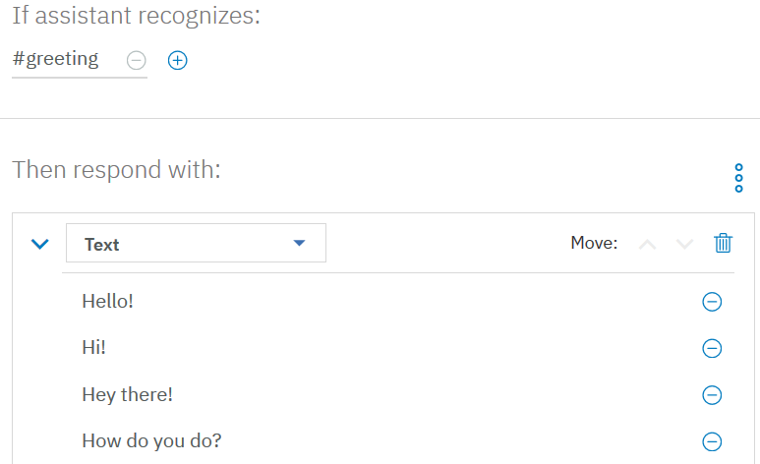
Responses
Responses:
The dialog response defines how to reply to the user.
The dialog response consists of the messages that are based on the identified intents, entities, or context that are communicated to the user when the dialog node is activated.
You can add variations to the response for a more natural experience.
Notes:
Responses
Responses are messages that are based on the identified intents and entities that are communicated to the user when the dialog node is activated. You can add variations of the response for a more natural experience or add conditions to pick one response out of many in the same dialog node.
The figure shows an example of adding different variations for greetings if the node is triggered by a greeting intent from the user.

Slide 44
Rich responses
Rich responses:
In addition to the default response type of text, you can return other interactive response types to enhance the user experience.
The following response types are supported:
Image: Embeds an image into the response.
Option: Adds a list of one or more options.
Pause: Forces the application to wait for a specified number of milliseconds before continuing with processing.
Notes:
Rich responses
In addition to the default response type of text, you can return responses with multimedia or interactive elements, such as images or clickable buttons to simplify the interaction model of your application and enhance the user experience.
The following response types are supported:
Image: Embeds an image into the response.
Option: Adds a list of one or more options. When a user clicks one of the options, an associated user input value is sent to the service. How options are rendered can differ depending on where you deploy the dialog. For example, in one integration channel, the options might be displayed as clickable buttons, but in another they might be displayed as a drop-down list.
Pause: Forces the application to wait for a specified number of milliseconds before continuing with processing. You can choose to show an indicator that the dialog is working on typing a response. Use this response type if you need to perform an action that might take some time.

Slide 45
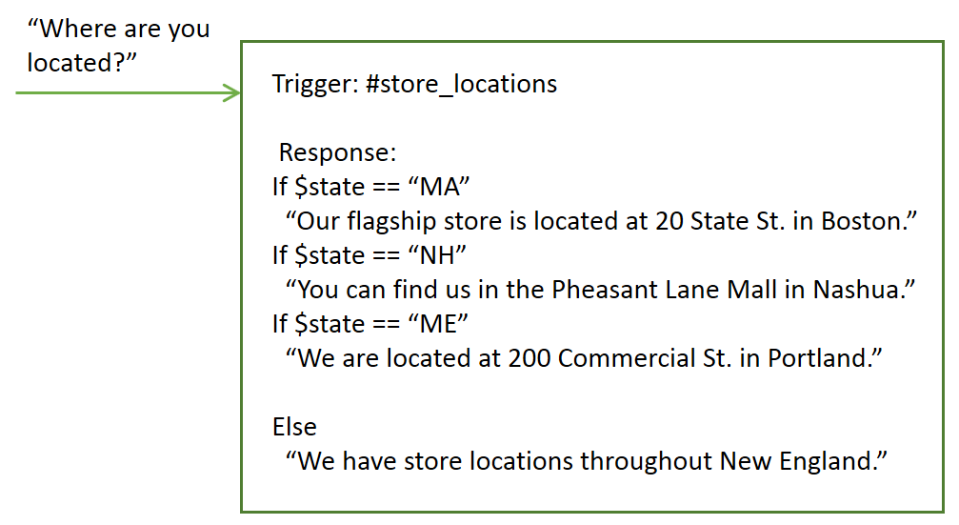
Multiple (conditional) responses
Multiple (conditional) responses
In a single dialog node, you can provide different responses, each one triggered by a different condition. Use this approach to address multiple scenarios in a single node.
Example: The service uses information that it collected earlier about the user's location to tailor its response and provide information about the store nearest the user.
Notes:
In a single dialog node, you can provide different responses, each one triggered by a different condition. Use this approach to address multiple scenarios in a single node.
In this example, the service uses information that it collected earlier about the user's location to tailor its response and provide information about the store nearest the user. The conditional responses are based on context values.
This single node now provides the equivalent function of four separate nodes.

Slide 46
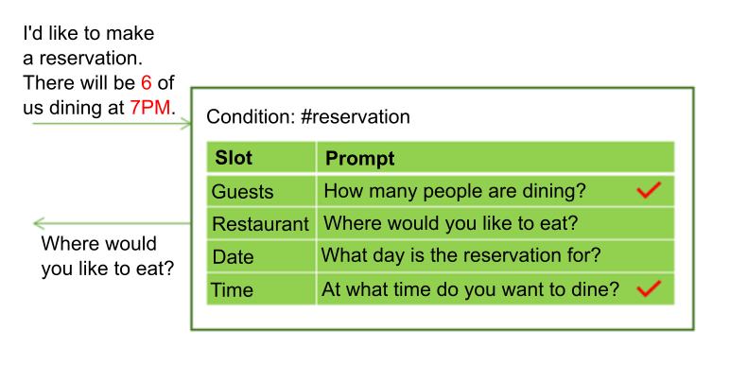
Watson Assistant dialog features (cont.)
Slots
Add slots to a dialog node to gather multiple pieces of information from a user within that node.
Slots collect information at the user’s pace. Details that the user provides are saved, and the service asks only for the details that the user did not provide.
Example: User-provided values for multiple slots in one input.
Notes:
Slots
Add slots to a dialog node to gather multiple pieces of information from a user within that node. Slots collect information at the users' pace. Details that the user provides are saved, and the service asks only for the details the use did not provide.
Example:
The user wants to reserve a table in a restaurant. The needed information is the number of guests, the date, the time, and the name of the restaurant. When asked, the user might provide values for multiple slots at once. For example, the input might include the information, ”There will be 6 of us dining at 7 PM”. This one input contains two of the missing required values: the number of guests and time of the reservation. The service recognizes and stores both of them, each one in its corresponding slot. It then displays the prompt that is associated with the next empty slot, which in this case asks the user, “Where would you like to eat?” to determine the restaurant slot and stores the response. After the user replies, the service asks, “What day will this take place?” to determine the date slot, stores it, and gives a reply.

Slide 47
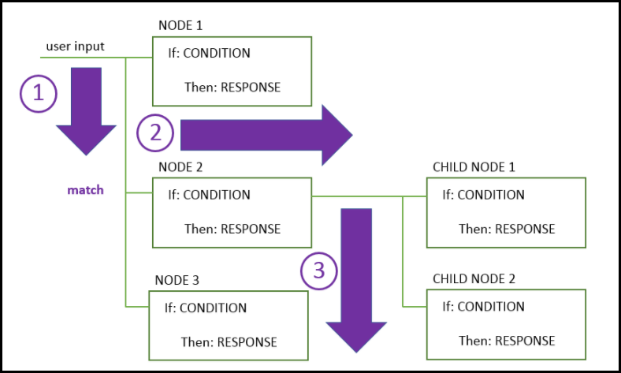
Dialog flow
Dialog flow
The dialog standard flow is processed from top to bottom and left to right.
Triggered by a successful condition.
It ends when it reaches the last node in the branch that it is following.
User input
Match
Notes:
The dialog is processed by the service from top to bottom.
As it travels down the tree, if the service finds a condition that is met, it triggers that node. It then moves from left to right on the triggered node to check the user input against any child node conditions. As it checks the children nodes, it moves again from top to bottom.
The service continues to work its way through the dialog tree until it reaches the last node in the branch that it is following.
If none of the conditions evaluates to true, then the response from the last node in the tree, which typically has a special anything_else condition that always evaluates to true, is returned.
When you start to build the dialog, you must determine the branches to include and where to place them. The order of the branches is important because nodes are evaluated from first to last. The first node whose condition matches the input is used; any nodes that come later in the tree are not triggered.

Slide 48
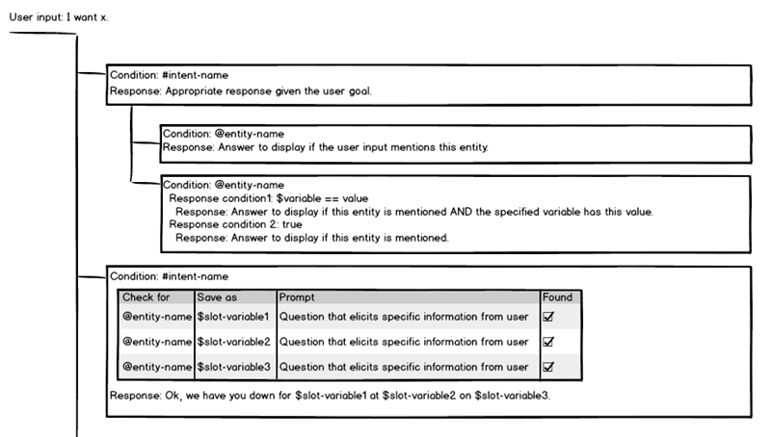
Watson Assistant components (cont.)
Dialog depiction
Notes:
Dialog depiction
This diagram shows a mockup of a dialog tree that is built with the GUI dialog builder tool. It contains two root dialog nodes. A typical dialog tree would likely have many more nodes, but this depiction provides a glimpse of what a subset of nodes might look like.
The first root node has conditions for an intent value. It has two child nodes and each have a condition on an entity value. The second child node defines two responses. The first response is returned to the user if the value of the context variable matches the value that is specified in the condition. Otherwise, the second response is returned.
This standard type of node is useful to capture questions about a certain topic and then in the root response ask a follow-up question that is addressed by the child nodes. For example, it might recognize a user question about discounts and ask a follow-up question about whether the user is a member of any associations with which the company has special discount arrangements. The child nodes provide different responses based on the user's answer to the question about association membership.
The second root node is a node with slots. It also has conditions on an intent value. It defines a set of slots, one for each piece of information that you want to collect from the user. Each slot asks a question to elicit the answer from the user. It looks for a specific entity value in the user's reply to the prompt, which it then saves in a slot context variable.
This type of node is useful for collecting details that you might need to perform a transaction on the user's behalf. For example, if the user's intent is to book a flight, the slots can collect the origin and destination location information, travel dates, and so on.

Slide 49
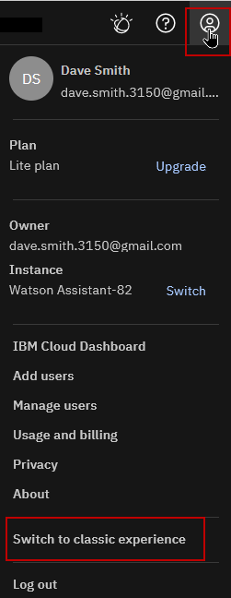
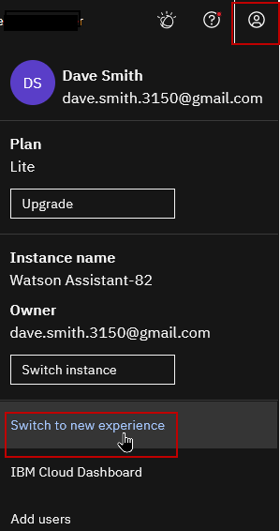
Switching the experience
You can switch back and forth between the new experience and the classic experience.
To switch between the new and classic experiences, following these steps:
From the Watson Assistant interface, click the Manage icon to open your account menu.
Select Switch to classic experience or Switch to new experience from the account menu.
Notes:
You can easily switch back and forth between the new experience and the classic experience. However, the new experience provides a simplified user interface, an improved deployment process, and access to the latest features.
To switch between the new and classic experiences, following these steps:
From the Watson Assistant interface, click the Manage icon to open your account menu.
Select Switch to classic experience or Switch to new experience from the account menu.
You don’t lose any work if you switch to a different experience, and other users of the same instance are not affected. However, keep in mind that any work you do in one experience is not available in the other experience. You can switch back and forth at any time.
References:
Switching the experience
https://cloud.ibm.com/docs/watson-assistant#welcome-new-assistant-switch-experience
Switching between new and classic experiences
https://cloud.ibm.com/docs/watson-assistant?topic=watson-assistant-switch-experience

Slide 50
Migrating to the new experience

Slide 51
Deciding which experience to use
If you are using a Watson Assistance instance that you created before October 2021 , you might still be using the classic Watson Assistant experience.
Consider the following questions to decide which experience you want to use:
Do you want to build a new actions-based assistant?
The new experience provides a simplified user interface that was designed around actions, and an improved deployment process
Are you working on an existing assistant built in the classic Watson Assistant?
If you have a dialog-based assistant, consider migrating it to the new experience so you can take advantage of the new process for publishing and deploying your assistant.
Do you want to convert an existing dialog-based assistant to use actions?
If you have a dialog-based assistant, but you want to reimplement it to use actions instead, start by migrating it to the new experience. You can then start to use actions alongside your dialog, and you can replace your dialog nodes with actions at your own pace.
Notes:
If you are using a Watson Assistance instance that you created before October 2021, you might still be using the classic Watson Assistant experience. To take advantage of the latest features, consider switching to the new experience.
Consider the following questions to decide which experience you want to use:
Do you want to build a new actions-based assistant?
The new experience provides a simplified user interface that was designed around actions, and an improved deployment process. If you plan to build an actions-based assistant, use the new experience for access to the latest features and improvements.
Are you working on an existing assistant built in the classic Watson Assistant?
If you have a dialog-based assistant that was built by using the classic Watson Assistant, and you are not currently planning to migrate to an actions-based assistant, you might still want to consider migrating it to the new experience so you can take advantage of the new process for publishing and deploying your assistant. Migrating to the new experience also makes it easy for you to begin using actions when you are ready.
For more information about how to migrate a dialog-based assistant to the new experience, see Activating dialog and migrating skills at https://cloud.ibm.com/docs/watson-assistant?topic=watson-assistant-activate-dialog
Do you want to convert an existing dialog-based assistant to use actions?
If you have a dialog-based assistant, but you want to reimplement it to use actions instead, start by migrating it to the new experience. You can then start to use actions alongside your dialog, and you can replace your dialog nodes with actions at your own pace.
For more information about using a dialog with actions, see Calling actions from a dialog at https://cloud.ibm.com/docs/watson-assistant?topic=watson-assistant-dialog-call-action
References:
Migrating to the new experience
https://cloud.ibm.com/docs/watson-assistant?topic=watson-assistant-migrate-overview
New Watson Assistant - Deployment process overview
https://cloud.ibm.com/docs/watson-assistant?topic=watson-assistant-publish-overview
Activating dialog and migrating skills
https://cloud.ibm.com/docs/watson-assistant?topic=watson-assistant-activate-dialog
Calling actions from a dialog
https://cloud.ibm.com/docs/watson-assistant?topic=watson-assistant-dialog-call-action

Slide 52
Migrating intents and entities
You can migrate your intents and entities from the classic Watson Assistant experience to the new Watson Assistant experience.
In the new experience, intents are known as example phrases in an action
In the new experience, entities are known as saved customer responses.
Downloading intents
You can download an intent to a CSV file, so you can then upload and reuse the examples as example phrases in the new Watson Assistant experience.
Downloading entities
You can download entities to a CSV file, so you can then upload and reuse them as saved customer responses in the new Watson Assistant experience.
Notes:
Downloading intents
You can download an intent to a CSV file, so you can then upload and reuse the examples as example phrases in the new Watson Assistant experience.
Go to the Intents page.
Select the intent that you want to download, and then click the Download icon .
Specify the name and location in which to store the CSV file that is generated, and then click Save.
Upload the examples from the intent as example phrases for a specific action in the new Watson Assistant.
For more information, see Uploading phrases https://cloud.ibm.com/docs/watson-assistant?topic=watson-assistant-understand-questions#understand-questions-uploading-examples
Downloading entities
You can download a number of entities to a CSV file, so you can then upload and reuse them as saved customer responses in the new Watson Assistant experience.
Go to the Entities page.
Select the entities that you want to download, and then click the Download icon .
Specify the name and location in which to store the CSV file that is generated, and then click Save.
Upload the entities as saved customer responses in the new Watson Assistant. For more information, see Uploading saved customer responses at https://cloud.ibm.com/docs/watson-assistant?topic=watson-assistant-collect-info#uploading-saved-customer-response
References:
Migrating intents and entities
https://cloud.ibm.com/docs/watson-assistant?topic=watson-assistant-migrate-intents-entities
Uploading phrases
https://cloud.ibm.com/docs/watson-assistant?topic=watson-assistant-understand-questions#understand-questions-uploading-examples
Uploading saved customer responses
https://cloud.ibm.com/docs/watson-assistant?topic=watson-assistant-collect-info#uploading-saved-customer-response

Slide 53
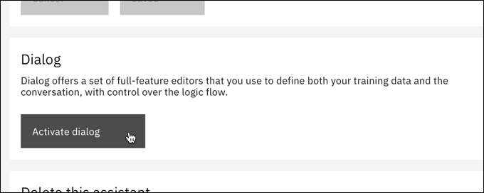
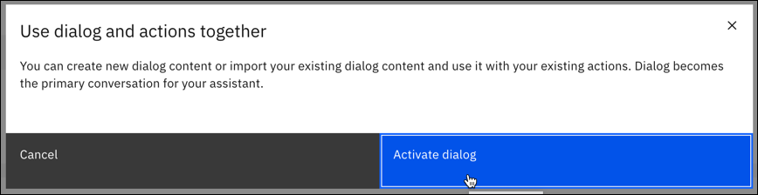
Activating dialog
To use an existing dialog skill, activate the dialog feature in your assistant.
To activate the dialog feature in the new experience:
Create or open an assistant where you want to use a dialog as the primary conversation with users.
Open Assistant settings.
Click Activate dialog.
In the confirmation that displays, click Activate dialog again.
Notes:
To use an existing dialog skill, activate the dialog feature in your assistant. Then, you can upload your existing skill.
Activating dialog
To activate the dialog feature in the new experience:
Create or open an assistant where you want to use a dialog as the primary conversation with users.
Open Assistant settings.
Click Activate dialog.
In the confirmation that displays, click Activate dialog again.
References:
Activating dialog and migrating skills
https://cloud.ibm.com/docs/watson-assistant?topic=watson-assistant-activate-dialog
Downloading a skill
https://cloud.ibm.com/docs/assistant?topic=assistant-skill-tasks#skill-tasks-download

Slide 54
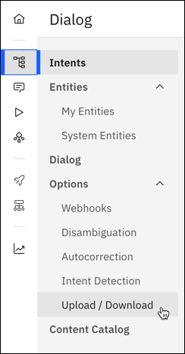
Migrating skills
Once the dialog feature is activated, you can start a new dialog conversation from scratch. Or if you have an existing dialog skill, you can migrate it to the new Watson Assistant.
To migrate an existing dialog skill:
Use the classic experience to download your dialog skill in JSON format.
In the new Watson Assistant, open the Dialog page.
In Options, choose Upload / Download.
On the Upload tab, upload the JSON file for your dialog skill.
Notes:
Migrating existing skills
Once the dialog feature is activated, you can start a new dialog conversation from scratch. Or if you have an existing dialog skill, you can migrate it to the new Watson Assistant.
To migrate an existing dialog skill:
Use the classic experience to download your dialog skill in JSON format.
In the new Watson Assistant, open the Dialog page.
In Options, choose Upload / Download.
On the Upload tab, upload the JSON file for your dialog skill.
References:
Downloading a skill
https://cloud.ibm.com/docs/assistant?topic=assistant-skill-tasks#skill-tasks-download
Migrating existing skills
https://cloud.ibm.com/docs/watson-assistant?topic=watson-assistant-activate-dialog#activate-dialog-upload

Slide 55
Calling actions from a dialog
In the new Watson Assistant, you can use actions with your primary dialog conversation.
A dialog takes precedence over actions.
You can use actions to supplement a dialog-based conversation, but the dialog drives the conversation with users to match their requests.
A dialog node calls an action to perform a task and then return to the dialog. From a single dialog node, you can make a call to either a webhook or an action, not both.
Choose the approach that best suits your needs:
Call an action if you want to perform a discrete and self-contained task, and then return to the dialog to be ready to address any new user requests.
Data that is collected from the user during action processing must be stored as a session variable for it to be passed to the dialog.
Call a webhook if you want to send a request to a web service to complete a task and return a response that can be used later by this dialog.
Notes:
In the new Watson Assistant, you can use actions with your primary dialog conversation. A dialog feature takes precedence over actions. You can use actions to supplement a dialog-based conversation, but the dialog drives the conversation with users to match their requests.
A dialog node calls an action to perform a task and then return to the dialog. From a single dialog node, you can make a call to either a webhook or an action, not both. Choose the approach that best suits your needs:
Call an action if you want to perform a discrete and self-contained task, and then return to the dialog to be ready to address any new user requests. Data that is collected from the user during action processing must be stored as a session variable for it to be passed to the dialog.
Call a webhook if you want to send a request to a web service to complete a task and return a response that can be used later by this dialog. For more information, see Extending your assistant with webhooks.
┌ Note ─────────────────
For step-by-step instructions, see “Adding a call to an action” at https://cloud.ibm.com/docs/watson-assistant?topic=watson-assistant-dialog-call-action#dialog-call-action-add
└────────────────────
References:
Calling actions from a dialog
https://cloud.ibm.com/docs/watson-assistant?topic=watson-assistant-dialog-call-action
Extending your assistant with webhooks
https://cloud.ibm.com/docs/watson-assistant?topic=watson-assistant-webhook-overview
Adding a call to an action
https://cloud.ibm.com/docs/watson-assistant?topic=watson-assistant-dialog-call-action#dialog-call-action-add

Slide 56
When to call an action from a dialog
You might want to call an action from a dialog in the following scenarios:
You want to perform an action from multiple dialog threads.
For example, you want to ask customers how satisfied they are with your service. You can define a single action to check customer satisfaction and call it from multiple branch-ending dialog nodes.
You want to see how actions works.
In this scenario, you can pick an intent for the action to handle. If you plan for the action to be called from the dialog only, you can define the user examples for the intent that triggers the dialog node.
┌ Note ─────────────────
For step-by-step instructions, see “Adding a call to an action” at https://cloud.ibm.com/docs/watson-assistant?topic=watson-assistant-dialog-call-action#dialog-call-action-add
└────────────────────
Notes:
You might want to call an action from a dialog in the following scenarios:
You want to perform an action from multiple dialog threads.
For example, you want to ask customers how satisfied they are with your service. You can define a single action to check customer satisfaction and call it from multiple branch-ending dialog nodes.
In this scenario, you don't need to define an intent, such as #check_satisfaction. The action is called automatically, replacing a jump to another dialog node's response.
You want to see how actions works.
In this scenario, you can pick an intent for the action to handle. If you plan for the action to be called from the dialog only, you can define the user examples for the intent that triggers the dialog node. When you define the action, you can add one customer example only, reducing the time that you need to spend building the action.
┌ Note ─────────────────
For step-by-step instructions, see “Adding a call to an action” at https://cloud.ibm.com/docs/watson-assistant?topic=watson-assistant-dialog-call-action#dialog-call-action-add
└────────────────────
References:
Calling actions from a dialog
https://cloud.ibm.com/docs/watson-assistant?topic=watson-assistant-dialog-call-action
Extending your assistant with webhooks
https://cloud.ibm.com/docs/watson-assistant?topic=watson-assistant-webhook-overview
Adding a call to an action
https://cloud.ibm.com/docs/watson-assistant?topic=watson-assistant-dialog-call-action#dialog-call-action-add

Slide 57
Enriching the chatbot

Slide 58
Persona
Creating a persona for your bot makes the bot friendlier and engages its users.
You can create a bot persona by adding some distinguishing characteristics to your chatbot.
Avatar: A face for your chatbot. A simple 2D graphic image, or even a 3D figure adds a nice touch, along with a name.
Adding a gender is not always a good idea. Generally, the chatbot should be gender-neutral, such as a friendly android (robot) or a friendly pet like a cat or a bird.
A voice: Makes a chatbot more interactive and adds value to its personality.
Easy to implement because of the many available text to speech services.
Notes:
Although it might be clear to the user that they are talking to a chatbot, creating a persona makes the bot friendlier and engages its users. You can create a bot persona by providing some distinguishing characteristics to your chatbot. For example, adding the following features can help to accomplish this goal:
Avatar An avatar adds a face to your chatbot. A simple 2D graphic image adds a nice touch, along with a name. Adding a gender is not always a good idea. Generally, the chatbot should be gender-neutral, such as a friendly android (robot) or a friendly pet like a cat or a bird.
A voice Adding a voice to your chatbot makes it more interactive and adds value to its personality. Doing so requires almost no effort because most text to speech services can be added to your existing output response text to transform it into audio.

Slide 59
Emotion and tone
Sentiment analysis can map user emotion input to a positive, negative, or neutral status.
Your chatbot can then sense the user’s positive comment and react to it, or sense a negative input and direct the conversation appropriately.
Tone analysis can perform more advanced interpretation of the user’s mood.
For example, it can detect whether the user is frustrated or thankful. The chatbot can then reply with a customized answer to each mood, giving your bot emotional AI that adds to its personality and makes it friendlier.
Notes:
Sentiment analysis can map user emotion input to a positive, negative, or neutral status. It adds emotion to your chatbot. Your chatbot can sense the user’s positive comment and react to it, or sense a negative input and direct the conversation appropriately.
Tone analysis can perform more advanced interpretation of the user’s mood. For example, it can detect whether the user is frustrated or thankful. The chatbot can then reply with a customized answer to each mood, giving your bot emotional AI that adds to its personality and makes it friendlier.

Slide 60
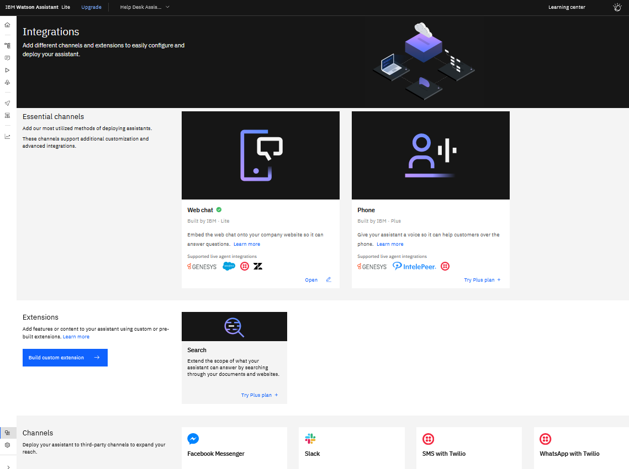
Integrations page
The page is organized into three sections:
Essential channels. The foundations of any assistant’s ability to reach users. They are web chat and phone.
Extensions. Customize your assistant by adding Search capabilities and connecting to third-party APIs with the Build custom extensions option.
Channels. Deploy your assistant to Slack, Facebook Messenger and SMS/WhatsApp with Twilio.
Notes:
For your assistant to reach its potential as a comprehensive user solution, it needs to seamlessly call out to and pull information from a wide variety of web apps.
Managing all the possible channels, integrations, and extensions might seem daunting task, but Watson Assistant simplifies the process with its Integrations page. The “Integrations” page consolidates all of your channels, extensions, and third-party connections in one spot, streamlining your ability to manage how and where users interact with your assistant.
To open the Integrations page, click the Integrations icon in the Watson Assistant home page.
The page is organized into three sections:
Essential channels. The foundations of any assistant’s ability to reach users. They are web chat and phone.
Extensions. Customize your assistant by adding Search capabilities and connecting to third-party APIs with the Build custom extensions option.
Channels. Deploy your assistant to Slack, Facebook Messenger and SMS/WhatsApp with Twilio.
References:
Watson Assistant Integrations: channel your knowledge
https://medium.com/ibm-watson/watson-assistant-integrations-channel-your-knowledge-909dfecae26
Adding integrations
https://cloud.ibm.com/docs/watson-assistant?topic=watson-assistant-deploy-integration-add

Slide 61
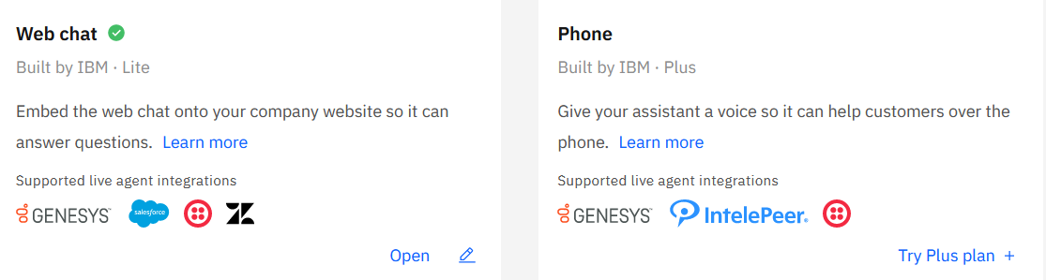
Integrations: Essential channels
The most common methods of deploying assistants.
Web chat is a code snippet that you can immediately embed in your company’s website.
Phone integration makes your assistant available to customers over the phone.
Notes:
Essential channels constitute the foundations of any assistant’s ability to reach users. They are web chat and phone. They are the most common methods of deploying assistants.
Web chat is a code snippet that you can immediately embed in your website.
When you build a custom user interface for your assistant, you spend a lot of time and effort writing code to solve typical UI problems. For example, you must keep up with browser support changes, manage scrolling behavior, validate input, and design the layout and styling. The time that you spend designing and maintaining the UI can be better spent building a quality assistant instead. When you use the web chat integration, Watson Assistant manages the user interface, so you can focus on designing conversational exchanges that address the unique business needs of your customers.
Phone integration. By adding the phone integration to your assistant, you can make your assistant available to customers over the phone. When you add the phone integration to your assistant, you can automatically generate a working phone number that is automatically connected to your assistant. Or, if you prefer, you can connect the assistant to your existing infrastructure by configuring an existing Session Initiation Protocol (SIP) trunk.
When your customer makes a phone call by using the telephone number connected to your assistant, the phone integration answers. The integration converts output from your assistant into voice audio by using the IBM Watson Text to Speech service. The audio is sent to the telephone network through the SIP trunk. When the customer replies, the voice input is converted into text by using the IBM Watson Speech to Text service.
┌ Note ─────────────────
Phone integration is available only to Plus or Enterprise plan users.
└────────────────────
References:
Web chat overview
https://cloud.ibm.com/docs/assistant?topic=assistant-web-chat-basics
Integrating the web chat with your website
https://cloud.ibm.com/docs/assistant?topic=assistant-deploy-web-chat
Integrating with phone
https://cloud.ibm.com/docs/assistant?topic=assistant-deploy-phone

Slide 62
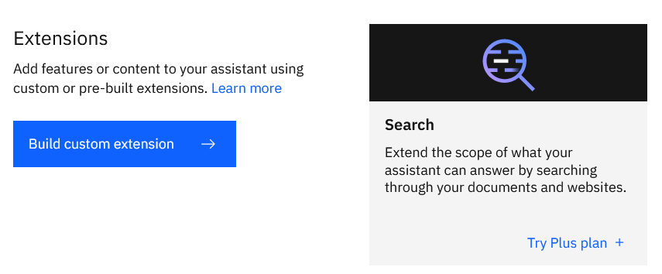
Integrations: Extensions
Add features or content to your assistant custom or pre-built extensions.
Requires an OpenAPI document (formerly known as Swagger), which is an open standard for describing and documenting REST APIs.
Search integration gives your assistant access to corporate data collections that it can mine for answers (Plus plan).
Notes:
If you need to integrate your assistant with an external service that has a REST API, you can build a custom extension by importing an OpenAPI document (previously known as Swagger).
After you create a custom extension, you can connect it to an assistant as an integration. In your actions, you can then define steps that interact with the external service by calling the extension.
For more information about connecting a custom extension to an assistant, see Add a custom extension at https://cloud.ibm.com/docs/watson-assistant?topic=watson-assistant-add-custom-extension.
You can put your subject matter expertise to work by adding search. The search integration gives your assistant access to corporate data collections that it can mine for answers.
When a search integration is added, your assistant can route complex customer inquiries to the IBM Watson Discovery service. Discovery treats the user input as a search query. It finds information that is relevant to the query from an external data source and returns it to the assistant. With search integration, the assistant can query existing company documents or data to see whether any useful information can be found and shared with the customer.
┌ Note ─────────────────
Search integration is available only to Plus or Enterprise plan users.
└────────────────────
References:
Add a custom extension
https://cloud.ibm.com/docs/watson-assistant?topic=watson-assistant-add-custom-extension
OpenAPI Specification
https://swagger.io/specification/
Watson Assistant Extensions Starter Kit
https://github.com/watson-developer-cloud/assistant-toolkit/tree/master/integrations/extensions
Adding a search integration
https://cloud.ibm.com/docs/watson-assistant?topic=watson-assistant-search-add

Slide 63
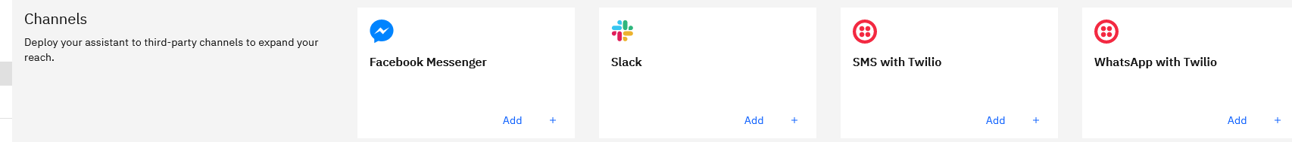
Integrations: Channels
Deploy your assistant to third-party channels to expand your reach.
Messaging with you assistant through messaging apps:
Facebook Messenger
Slack
SMS with Twilio
WhatsApp with Twilio
Notes:
The final section of the “Integrations” page contains quick links to configure your assistant for deployment to four of the most widely used digital messaging apps:
Facebook Messenger
Slack
SMS with Twilio
WhatsApp with Twilio
By using an existing account with these services, you can make your assistant available through these apps in a matter of minutes.
References:
Adding integrations
https://cloud.ibm.com/docs/watson-assistant?topic=watson-assistant-deploy-integration-add
Watson Assistant Integrations: channel your knowledge
https://medium.com/ibm-watson/watson-assistant-integrations-channel-your-knowledge-909dfecae26

Slide 64
Speech recognition
You can use IBM, Google, and Microsoft speech to text services to enable your chatbot to understand user speech.
This feature is heavily used in home automation chatbots and automation tasks in general.
For example, in Microsoft Windows you can give commands to Cortana by using your voice without touching a key or pressing a mouse button. You can do the same with Siri on the Apple iPhone.
Notes:
With advancements in speech to text technology, you can use IBM, Google, and Microsoft speech to text services to enable your chatbot to understand user speech.
This feature is heavily used in home automation chatbots and automation tasks in general. For example, in Microsoft Windows you can give commands to Cortana by using your voice without touching a key or pressing a mouse button. You can do the same with Siri on the Apple iPhone.

Slide 65
Unit summary
Describe the experiences available in Watson Assistant to build chatbots.
Describe the main components of new Watson Assistant.
Explain how to build a chatbot with Actions and Steps.
Describe the main components of classic Watson Assistant.
Describe how to build a chatbot with Intent, Entities, and Dialog Skills.
Compare action-based conversations and dialog-based conversations.
Describe when and how to migrate from classic to new Watson Assistant.
Test a chatbot.
Explain how to enrich a chatbot.

Slide 66

Review questions
True or False: In Watson Assistant, Skill can contain one or more entities.
True or False: In Watson Assistant, @type is an example of an intent.
True or False: The dialog flow is from top to bottom and left to right.
Which of the following response types can be used in a dialog node?
Image
Text
Option
All the above

Slide 67
Review questions (cont.)
#pay_bill is an example of ____
Intent
Entity
Skills
Workspace
A branching conversation flow that defines how your chatbot responds when it recognizes the input from the user.
Intent
Dialog
Condition
Entity
True or False: @menu is an example of intent.

Slide 68
Review questions (cont.)
True or False: Actions can be called from a Dialog.
Which if the following are examples of actions (select all that apply)?
Pay bill
Menu
Balance in bank account
Withdraw money
Account number
a and b.
a, c, d.
b and e

Slide 69
Review questions (cont.)
It is used to insert the context that you gathered from the customer.
Action variable
Condition
Entity
Intent
Webhook
True or False: The new Watson Assistant experience is built around Dialog.

Slide 70

Review answers
True or False: In Watson Assistant, Skill can contain one or more entities.
True or False: In Watson Assistant, @type is an example of an intent.
True or False: The dialog flow is from top to bottom and left to right.
Which of the following response types can be used in a dialog node?
Image
Text
Option
All the above

Slide 71
Review answers (cont.)
#pay_bill is an example of ____
Intent
Entity
Skills
Workspace
A branching conversation flow that defines how your chatbot responds when it recognizes the input from the user.
Intent
Dialog
Condition
Entity
True or False: @menu is an example of intent.

Slide 72
Review answers (cont.)
True or False: Actions can be called from a Dialog.
Which if the following are examples of actions (select all that apply)?
Pay bill
Menu
Balance in bank account
Withdraw money
Account number
a and b.
a, c, d
b and e

Slide 73
Review answers (cont.)
It is used to insert the context that you gathered from the customer.
Action variable
Condition
Entity
Intent
Webhook
True or False: The new Watson Assistant experience is built around Dialog.

Slide 74
Exercise: Getting started with Watson Assistant

Slide 75
Exercise objectives
This exercise introduces IBM Watson Assistant and walks you through the process of creating a very simple chatbot with Watson Assistant.
After completing this exercise, you should be able to:
Create a Watson Assistant service instance.
Create a Watson Assistant dialog skill.
Add intents.
Build a dialog.

Slide 76
Exercise: Help Desk Chatbot

Slide 77
Exercise objectives
This exercise describes how to create a chatbot and publish it quickly without coding by using the IBM Watson Assistant service. For this example, you create a Help Desk chatbot. However, you can customize the chatbot to take any other role, such as delivery service, Q&A, student assistant, and more.
After completing this exercise, you should be able to:
Add intents and entities that are imported from previous assistant.
Build a dialog.
Create an assistant and add dialog skills to it.
Publish a chatbot to a webpage.

Slide 78
Exercise: Exploring the new Watson Assistant: Creating a retail customer service chatbot

Slide 79
Exercise objectives
This exercise introduces the new Watson Assistant capabilities and walks you through the process of creating actions with steps, conditions, and variables for a retail customer service chatbot.
After completing this exercise you should be able to:
Create a Watson Assistant service instance.
Create actions.
Create actions with conditions.
Create actions with variables.

